Slide 1
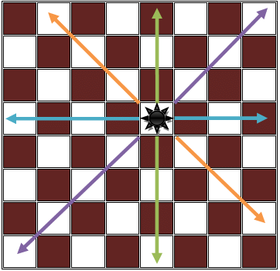
N- Queens Problem
Introduction of N-Queen Problem
Rules of N-Queen Problem
Solve using Backtracking Method

Slide 2
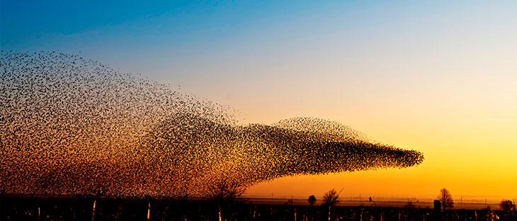

Particle Swarm Optimization (PSO)
What is Particle Swarm Optimization (PSO)?
Why Particle Swarm Optimization (PSO)?

Slide 3
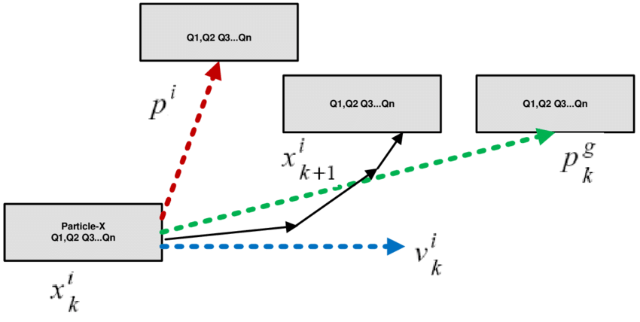

Particle Swarm Optimization (PSO) Algorithm
Initialization:
a. Generate First Swarm by random position Xi
b. Initialize the velocity Vi with smallest random number
Loop Until (Termination Criteria)
For i range (1,PopulationSize)
Revaluate Function:
a. If f(Xi k) < f(Pbesti) then Xi k = Pbesti
b. If f(Pbesti) < f(Gbesti) than Pbesti =Gbesti
End

Slide 4
Conclusion
Inspiration from Nature
Collective Behavior
Fast-Growing

Slide 5
Thank You

